Slide 1




Career Center Workshop
Christina Chapman, PhD

Slide 2
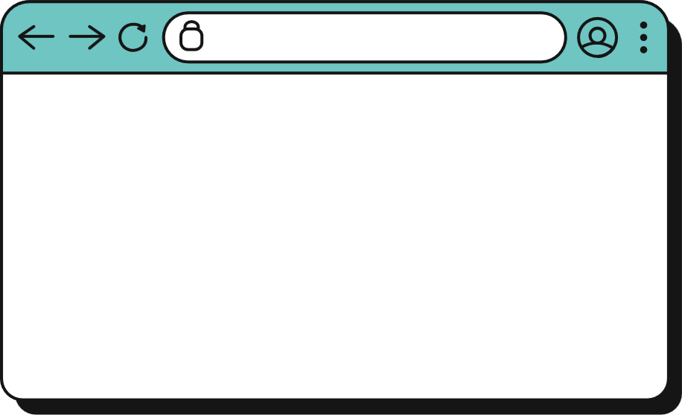



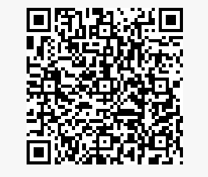

uncw.edu/career
Check-in!
Fisher University Union 2035,
Wilmington, NC 28403
Office Hours:
Monday-Friday: 8am-5pm
Friday Annex
Wednesday-Friday: 8am-5pm
Express Hours:
Monday-Friday: 2-4pm
Phone: (910)-962-3174
careercenter@uncw.edu

Slide 3

The Resume is…
An advertisement; a highlight of your background; an individually designed document; used by employers as a screening device; just ONE piece of the job search process
There is no right and wrong when it comes to content and format. It is up to you to select the appropriate content that best highlights you.

Slide 4
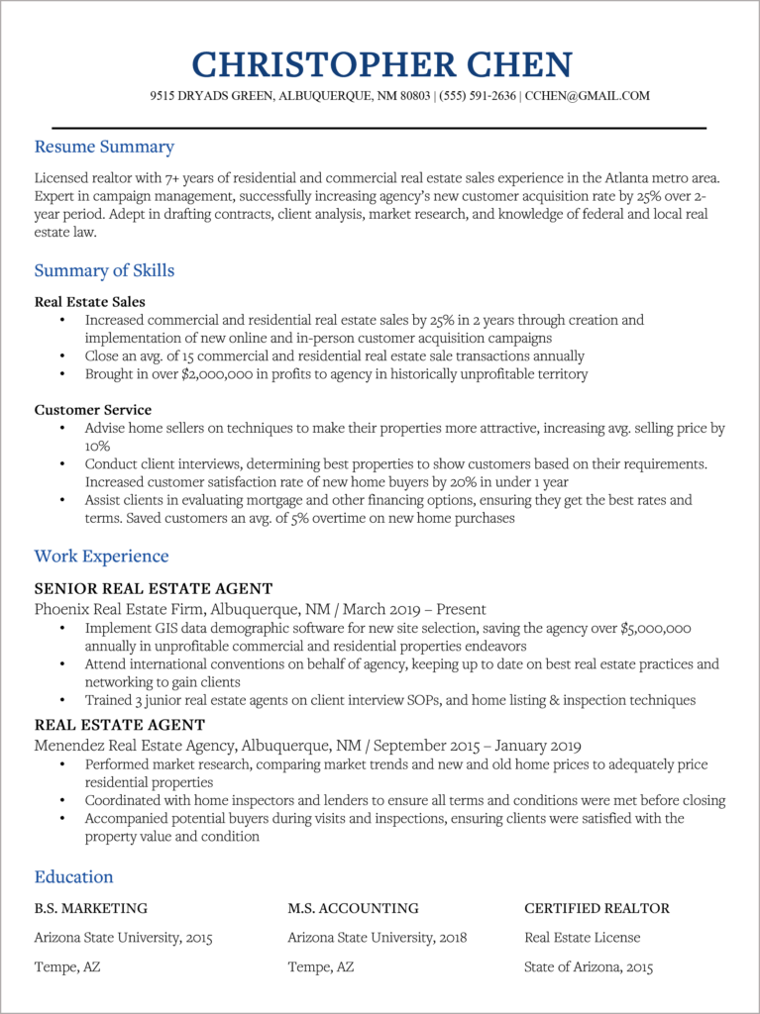
Review the Basics
Focus on Skills
Write for the audience
0.5 to 1” margins
10-12 point font → be consistent
Reverse chronological order – newest first
No personal pronouns

Slide 5
Format
Professional Summary (optional)
Education
Study Abroad
Dean’s List
Skills (Technical) & Certifications
Programming Languages
Algorithms & Data Structures
Cloud Computing
Machine Learning & AI
Database Management
Developer Tools
Technologies/Frameworks
Libraries
Databases
Related Coursework (optional)
Include if limited experience
Related Experience
Industry Experience
Internships
Academic Projects
Research Experience
Freelance & Contract Work
Open Source Contributions
Other Experience
Campus Involvement
Leadership
Activities

Slide 6
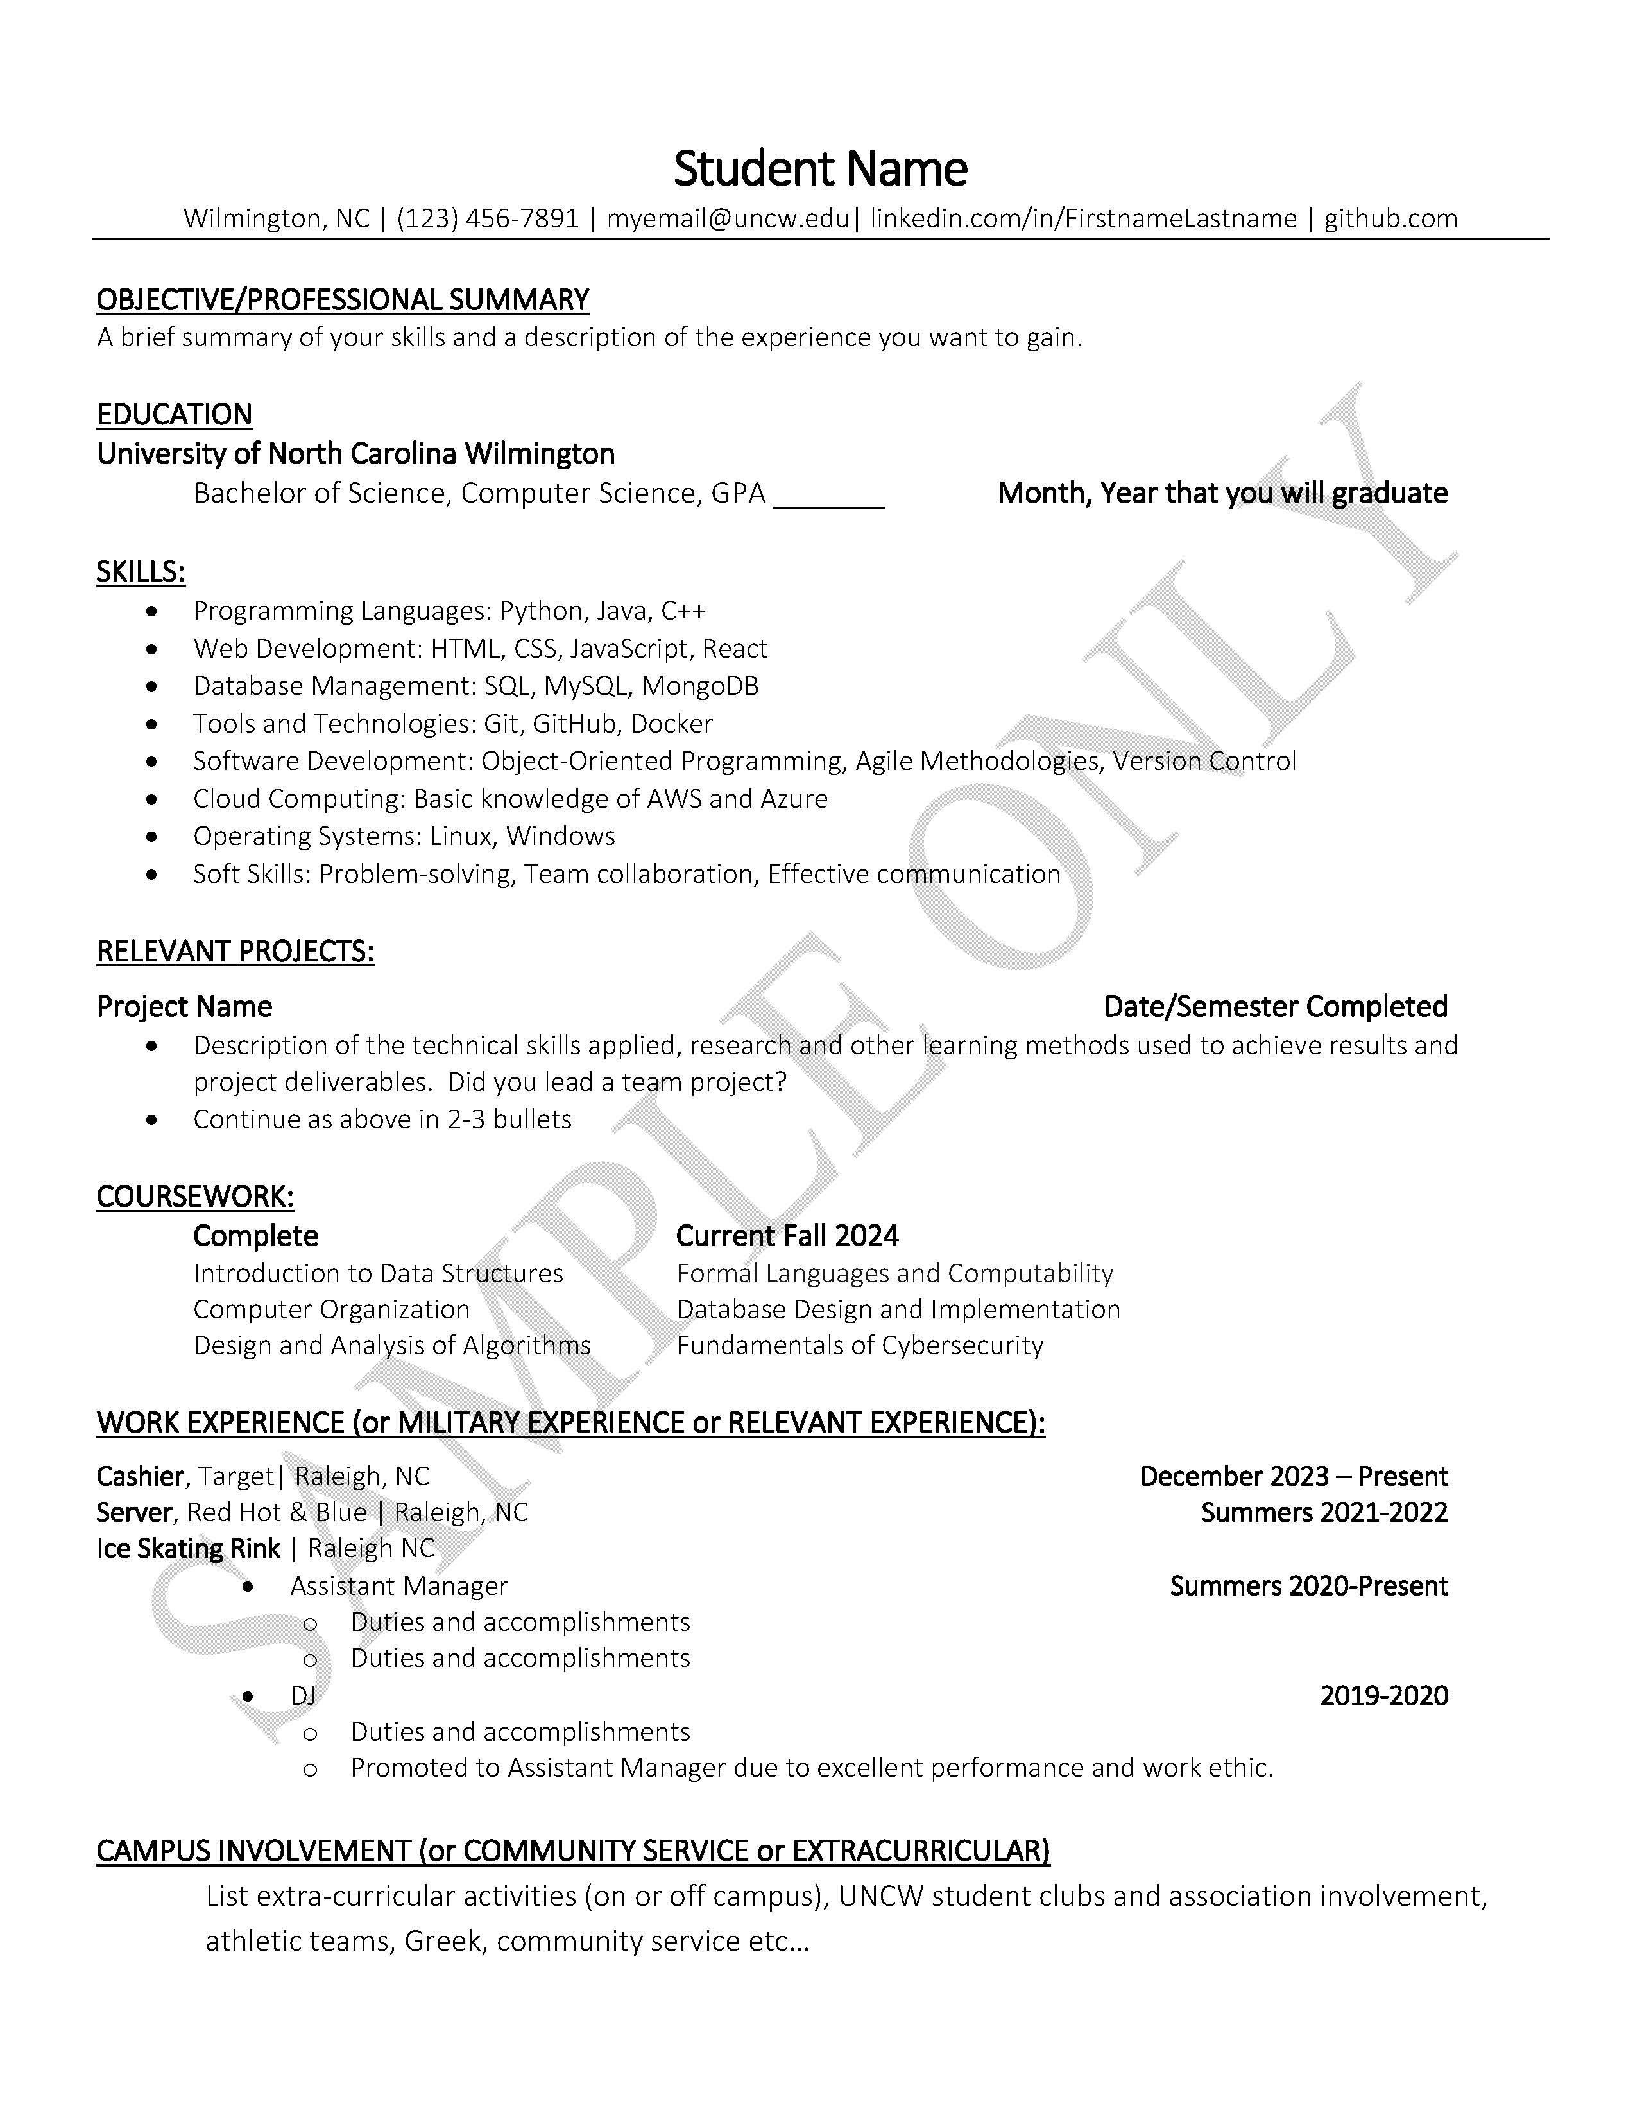
Name and Contact Info:
Name in large font (14-18)
City, State (no full mailing address)
Phone Number
Professional Email
LinkedIn
GitHub

Slide 7
Education:
Make sure headers stand out and help organize information
Spell out degree
Expected graduation date
Awards, honors

Slide 8
Skills:
Programming Languages
Web Development
Database Management
Tools & Technologies
Software Development
Cloud Computing
Operating Systems
Certifications

Slide 9
Relevant Projects:
Projects that demonstrate technical skills & problem-solving
Work done in class, internships, hackathons, or personal time
Include tools, languages, and frameworks used
Highlight impact, outcomes, or what you learned
Link to GitHub or portfolio if available
Include the date or semester completed

Slide 10
Relevant Coursework:
Completed Coursework/Courses in Progress
List relevant technical courses that align with career goals
Prioritize upper-level or specialized courses
Avoid listing general education or unrelated electives
Use bullet points or clean inline list format
Tailor to match description

Slide 11
Experience:
List in reverse chronological order
Include Employer, Location, Role, Dates
Lead with action verb in correct tense and give detailed description highlighting skills and responsibilities
Quantify information when possible (use $ and #)
Highlight tools, technologies, and responsibilities

Slide 12
Campus Involvement and/or
Leadership
ANY clubs or organizations
Roles/Duties included
Dates and descriptions of skills/ knowledge, competencies as appropriate are included.

Slide 13

Formula for Perfect Statements
What You Did
How/Why You Did It
Action Verb

Slide 14
Action Verbs that Describe Skills
Achieved
Advised
Analyzed
Assisted
Budgeted
Coached
Conducted
Coordinated
Counseled
Solved
Supervised
Surveyed
Trained
Created
Designed
Facilitated
Increased
Implemented
Led
Managed
Motivated
Organized
Performed
Planned
Promoted
Scheduled
Served

Slide 15
Include Industry-Specific Words
Applicant Tracking Systems (ATS) - “a type of software application that handles the recruitment process, namely by sorting through thousands of resumes, to determine which ones are the best fit for the positions for which they were submitted.” (jobscan)
Examples:
Aided Monitor
Prioritized Mediate
Educate Problem Solve
Help/Assist/Support Administer
*Visit onetonline.org for examples of industry-specific words.

Slide 16
Resume Statement Examples
Before: Created a database for a class project using MySQL
After: Created a relational database using MySQL to organize student records and demonstrate normalization principles
Before: Helped update software on lab computers.
After: Assisted with updating operating systems on 20+ lab computers to ensure compatibility with new instructional software and improve system performance
Before: Used Excel to clean and analyze survey data
After: Cleaned and analyzed survey data in Excel using pivot tables and conditional formatting to identify patterns for a class project
Before: Worked with a team to complete a web development project
After: Collaborated with a team of four to design and deploy a responsive website using HTML, JavaScript, and CSS as part of a semester-long capstone project.

Slide 17
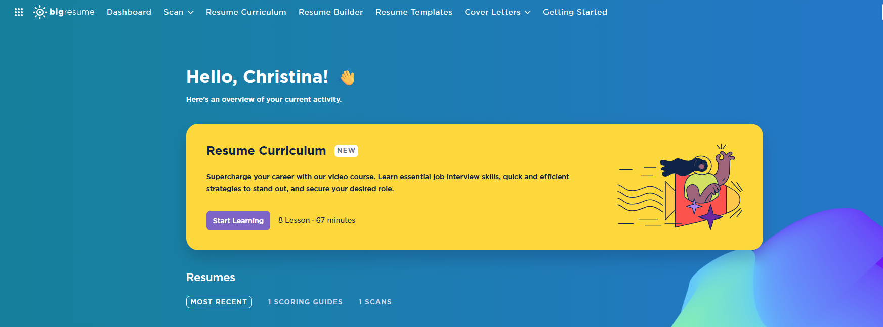
BigResume

Slide 18


Networking

Slide 19
What is LinkedIn?
More than a “Professional Facebook”
A business-oriented social networking website that many people use for staying connected with business associates, clients, and former colleagues.
Largest professional networking website/platform today (close to 800 million users, with over 250 million monthly active users)
One of the best ways to promote and market your personal brand

Slide 20
Informational Interviews
The main goal of informational interviewing is to obtain information and advice through one-on-one, comfortable conversations with people already working in a particular career. Informational interviews are initiated and controlled by the student.
To gain information and advice about career fields or job search strategies
To validate the choice of career by investigating the day-to-day experiences of someone working in the field
To make and grow your professional network

Slide 21
Informational Interviews
Questions about the career:
How did you become interested in this career?
How does this career and job align with your passions?
What is a typical workday like? What are your job responsibilities?
What are the rewards, challenges, and frustrations of working in this career?
What advice do you have for someone preparing to enter this career?
Questions about the organization/industry:
How does your position fit within the organization/industry/career field?
What is unique to your organization? Who are your competitors?
Questions about future growth:
What are some of the current issues and trends in this field?
Notes:
.

Slide 22
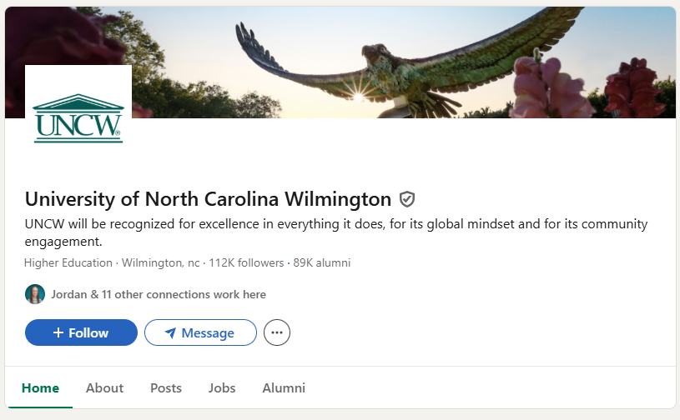
Informational Interviews

Slide 23
Professionalism During a Company Tour
What to Expect
A mix of presentations, facility walkthroughs, and Q&A sessions
You may meet HR reps, team leads, or recent grads
They’re observing you too, so treat it like a mini-interview
Professionalism
Dress appropriately (business casual unless told otherwise)
Arrive early and be attentive
Avoid checking your phone
Follow up with a LinkedIn connection or thank-you message

Slide 24
Professionalism During a Company Tour
What to Ask
What does a typical day look like for someone in an entry-level role here?
What skills or experiences do you look for in interns or new hires?
How does your team collaborate across departments?
What advice would you give to students preparing for a career in this field?
How do people typically grow or advance in their careers in this company?
Is there anything you wish you had known when you were starting out?
Can I follow up with you on LinkedIn if I have more questions?

Slide 25

Want More Help? How to get help from the Career Center
Individual Appointment
Career Express Lane
Email the Career Center or visit Handshake to make an appointment.
Appointments can help with:
Major Exploration
Career Exploration
Job Search Strategies
Planning for Grad School
Mock Interviews
Resume or Cover Letter Review
Internship Preparation
Meant for simple questions or quick resume or cover letter checkup. These are 15-minute mini appointments at the Career Center.
Express Hours: In-Person
Monday – Friday, 2:00pm–4:00pm

Slide 26


Questions?
Christina Chapman|chapmancm@uncw.edu | 910-962-7291

